Slide 1

Engaging students with sports examples through SCORE
Robin Lock, Ivan Ramler, Nick Clark, Michael Schuckers
USCOTS Breakout, July 2025
Sports Content for Outreach, Research, and Education

Slide 2
In this breakout...
What is Score?
Level 1 – Instructor Choice (Modules)
Level 2 – Student Choice (Datasets)
Level 3 – Student contribution
(Review/Contributions)

Slide 3

What is SCORE?

Slide 4
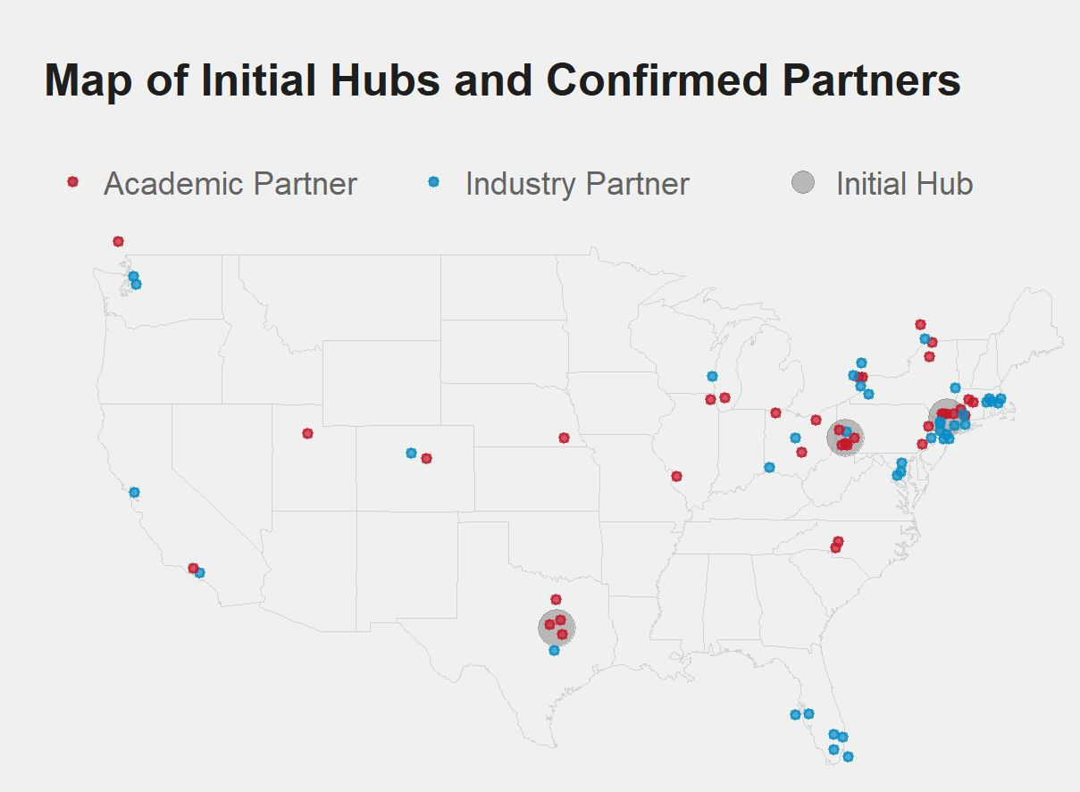
Initial Network
Over 80 initial confirmed partners in academia, industry and media
3 initial hubs
PIT - Carnegie Mellon, Pitt
NY - St Lawrence, West Point, Yale
TX - Baylor
High level advisory board from academia and industry

Slide 5
Levie 1 – Instructor Choice (Modules)
A SCORE module is a set of teaching resources built around one (or more) sports-related datsets
Plug and Play into your classroom with flexibility
Open Access (download and (usually edit)
Peer Vetted with DOIs (Pedagogy, Industry, Student)
Sports motivated with background materials
Diversity of sports esp. Non-traditional sports

Slide 6
Module Components
Sports Setting
Introduction/Motivational Video
Learning Goals/Methods (Statistical/Data Science)
Dataset(s)
Data Glossary
Exercises/Activities (inline or downloadable worksheets)
Solutions
Conclusion

Slide 7
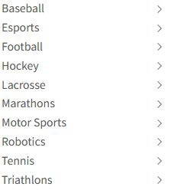
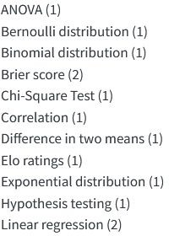
Module Repository
19 Published Modules 70 more in pre-print
13 different sports among published Numerous more in pre-print
Searchable by topic
What other modules would you use?

Slide 8
Existing SCORE Modules

Slide 9
Three Module Examples

Slide 10
Learning Objectives
Most of those can be answered reasonably with undergraduate level statistics and data science tools.
Students get experience with
Solving real problems
Joining data from multiple sources, working with several different types of data
Data exploration/visualization
Multivariable thinking, need for regression or something else
Modeling
Interpretation
Etc
Most of the data is publicly available, or can be done with public available alternatives Exception: player tracking data

Slide 11
Sports Analytics in Education
Dozens/hundreds of educators around the world have developed
hundreds of examples,
using multiple sports, and
focusing on a variety of statistics and data science topics
Missing:
Standardization
Completeness
Consolidation/centralization
Content creation is decentralized = good
Content is decentralized = less convenient
Industry/media perspective

Slide 12
Enter SCORE!
SCORE with Data: building a sustainable national network for developing and disseminating Sports Content for Outreach, Research, Education in data science
Unique NSF-funded project combining academia, professional sports, and media to build a repository of educational materials for statistics & data science via sports applications/analytics
Strong emphasis on outreach, inclusiveness, and building pipelines

Slide 13
Sustainable National Network
Why a network?
Decentralized/crowdsourced content creation
Ideally sustainable
Diverse experience and skills
Academia, industry and media
Key part of review process
Pre-existing informal network already

Slide 14
SCORE with Data
Building a sustainable national network for developing and disseminating Sports Content for Outreach, Research, Education in data science

Slide 15
SCORE with Data
Building a sustainable national network for developing and disseminating Sports Content for Outreach, Research, Education in data science

Slide 16
SCORE with Data
Building a sustainable national network for developing and disseminating Sports Content for Outreach, Research, Education in data science

Slide 17
Disseminating Content
ScoreNetwork.org

Slide 18
SCORE Module and Data Repository
Modules can be found at: https://modules.scorenetwork.org/
Data can be found at: https://data.scorenetwork.org/

Slide 19
Module
Educational materials for statistics and data science Plug and Play into your classroom with flexibility Open Access (download and edit)
Peer Vetted with DOIs
Pedagogical, Industry, Student (optional) Following best educational practices
Sports motivated with background materials Diversity of sports esp. Non-traditional sports

Slide 20
Examples: Published
Outliers using League of Legends data
Correlations with Female Ironman Lake Placid Finisher data Lacrosse faceoff proportions hypothesis testing
NHL shooting percentages with linear regression

Slide 21
Module Repository
19 Published Modules 70 more in pre-print
13 different sports among published Numerous more in pre-print
Searchable by topic
What other modules would you use?

Slide 22
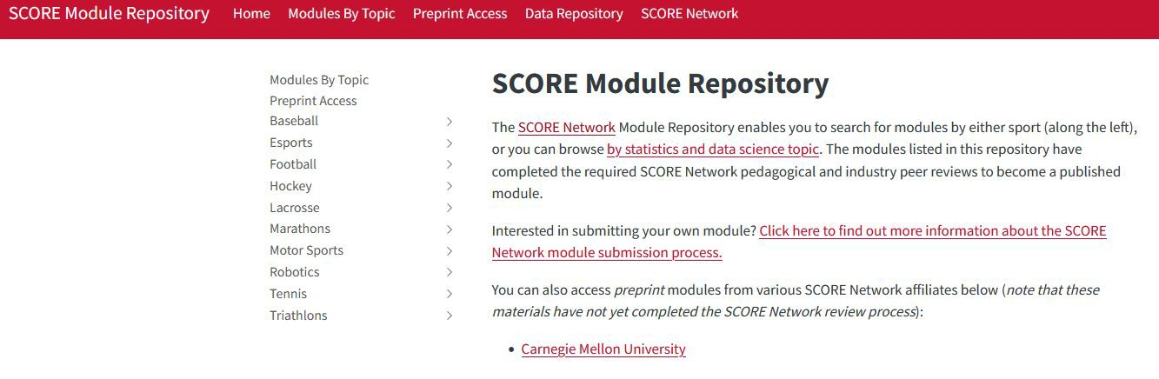
Module landing page

Slide 23
DOI (Digital Object Identifier)
Permanent and persistent link to modules/data
Makes it easier to discover or search for modules/educational materials Adds credibility and traceability to professional products

Slide 24

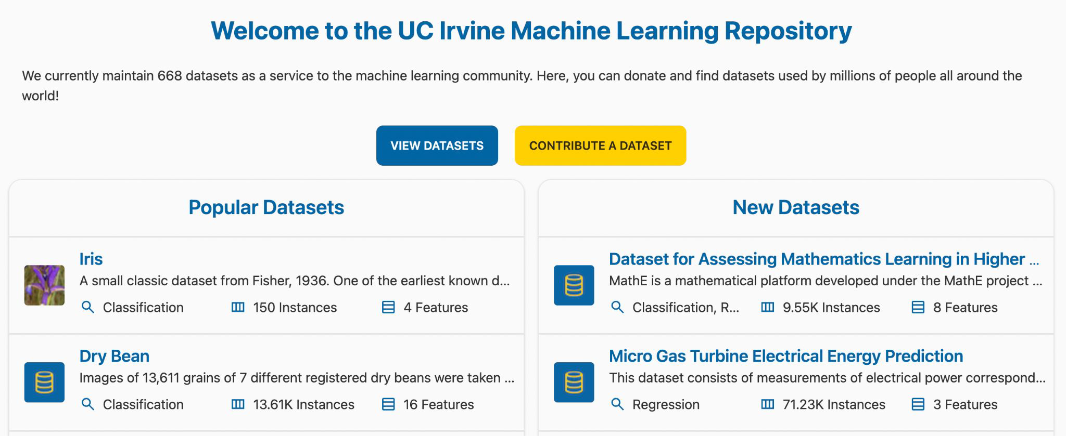

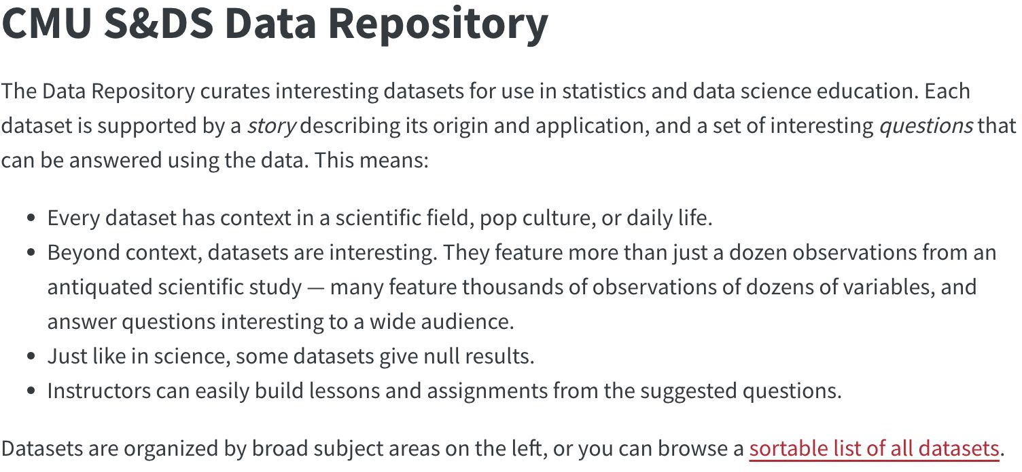
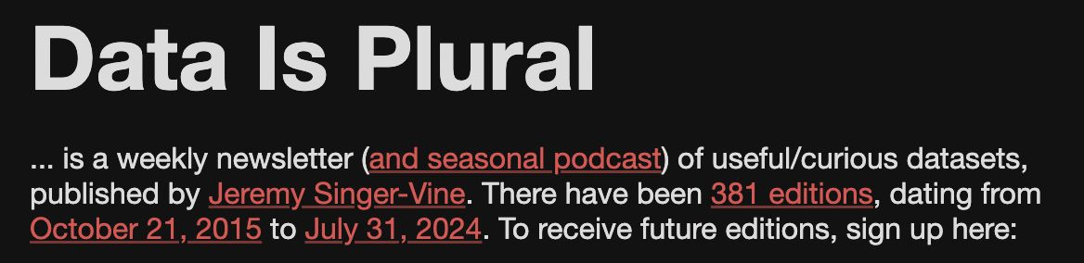
Datasets for class?
Check out: https://cmustatistics.github.io/data-repository/

Slide 25




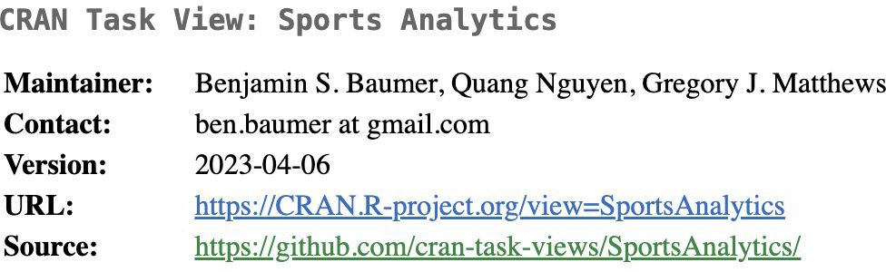
What about sports datasets?

Slide 26
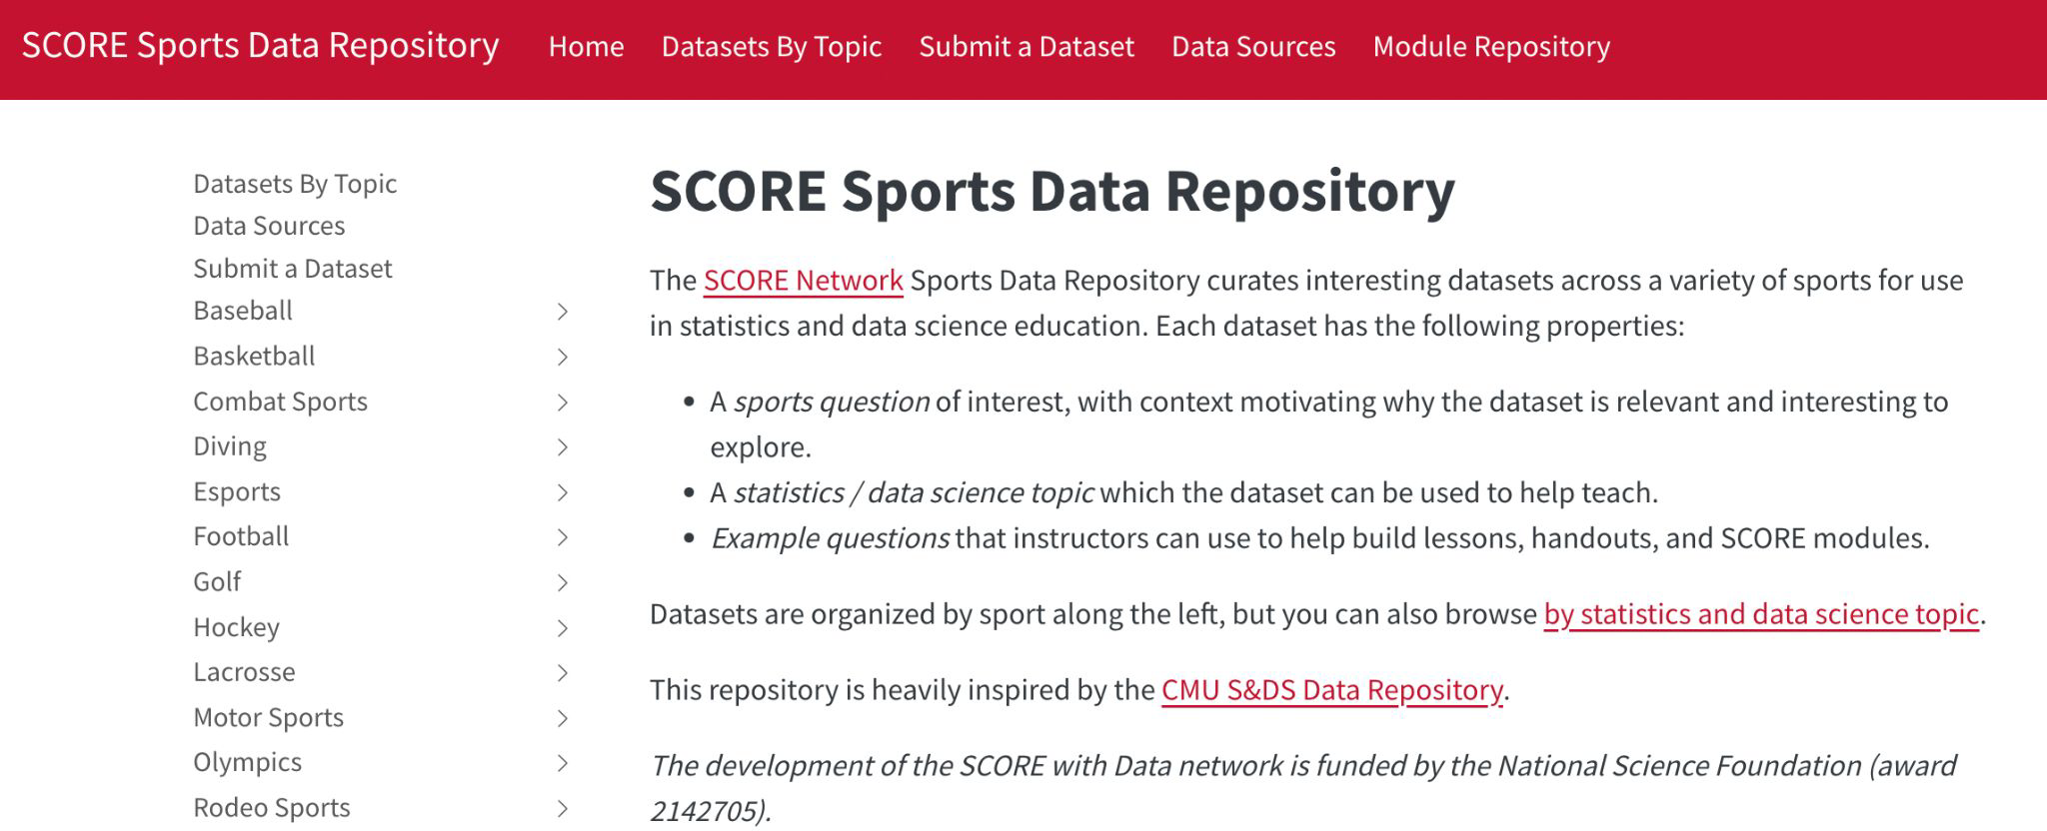
SCORE Data Repository https://data.scorenetwork.org/

Slide 27
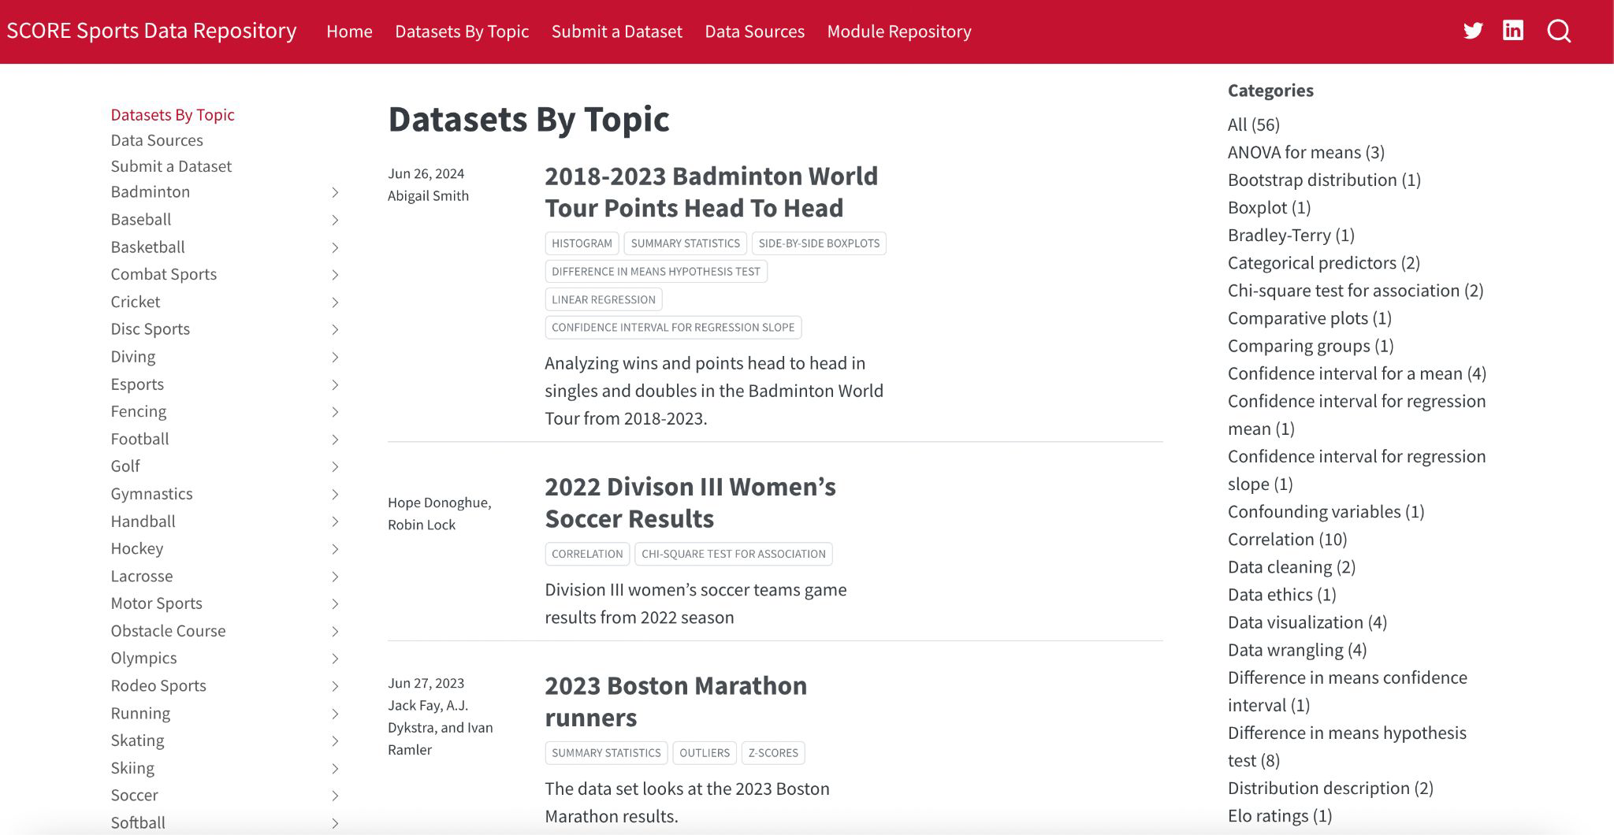
SCORE Data Repository https://data.scorenetwork.org/
Features over 70 datasets across more than 30 different sports
Can search for datasets by sport and by statistics & data science topic

Slide 28
What does every dataset include?
Descriptive title, e.g., Women’s National Basketball Association Shots
Brief description the data background, potentially include a brief summary of the sports problem and statistical situation
List of relevant statistics and data science topics/categories for tags
Information about the source of the data motivating its usage
Description of dataset: what does one row represent? README file serving as the data dictionary for the columns
Example questions associated with the data

Slide 29
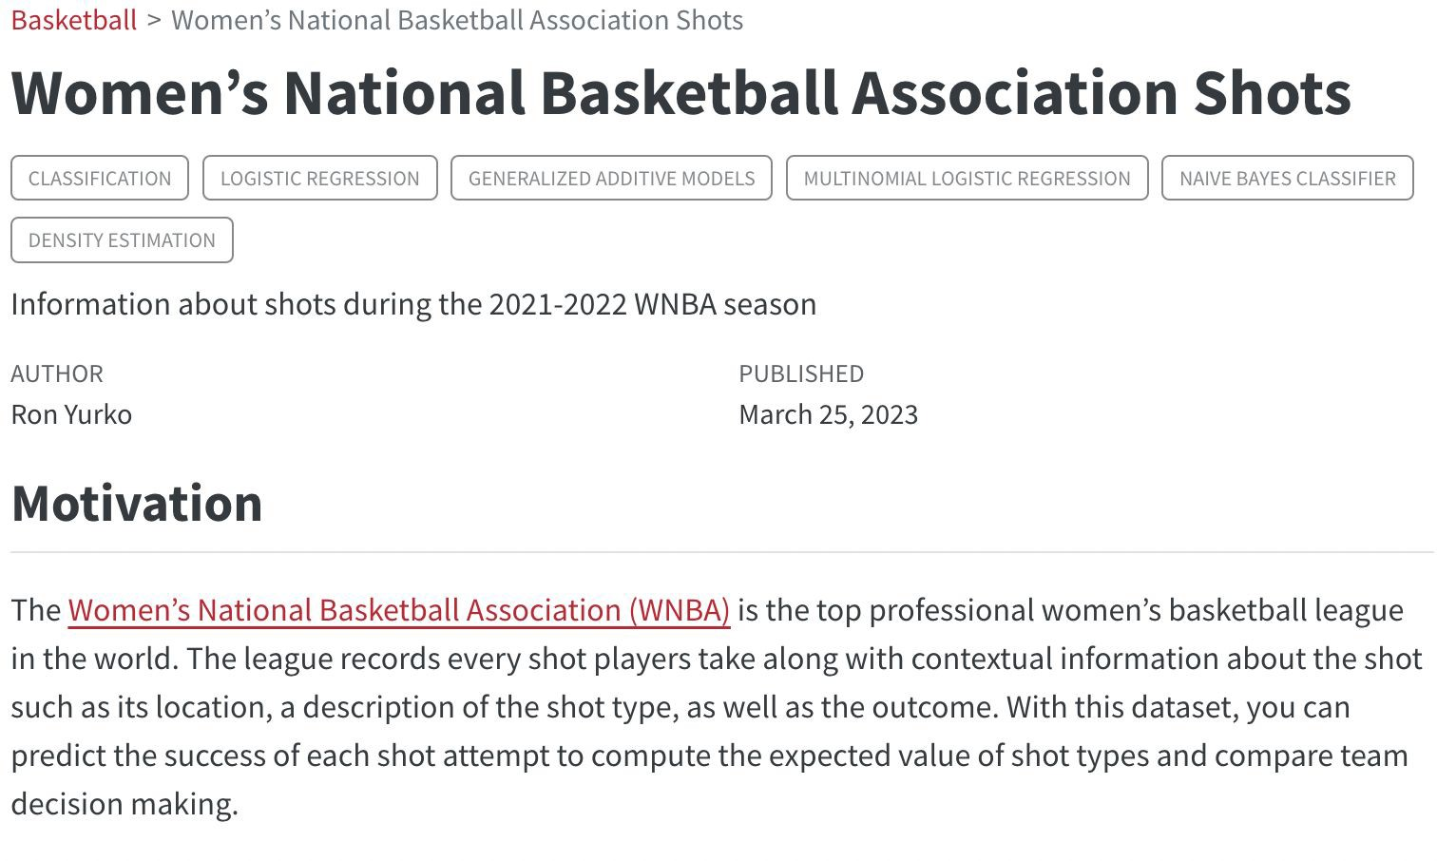
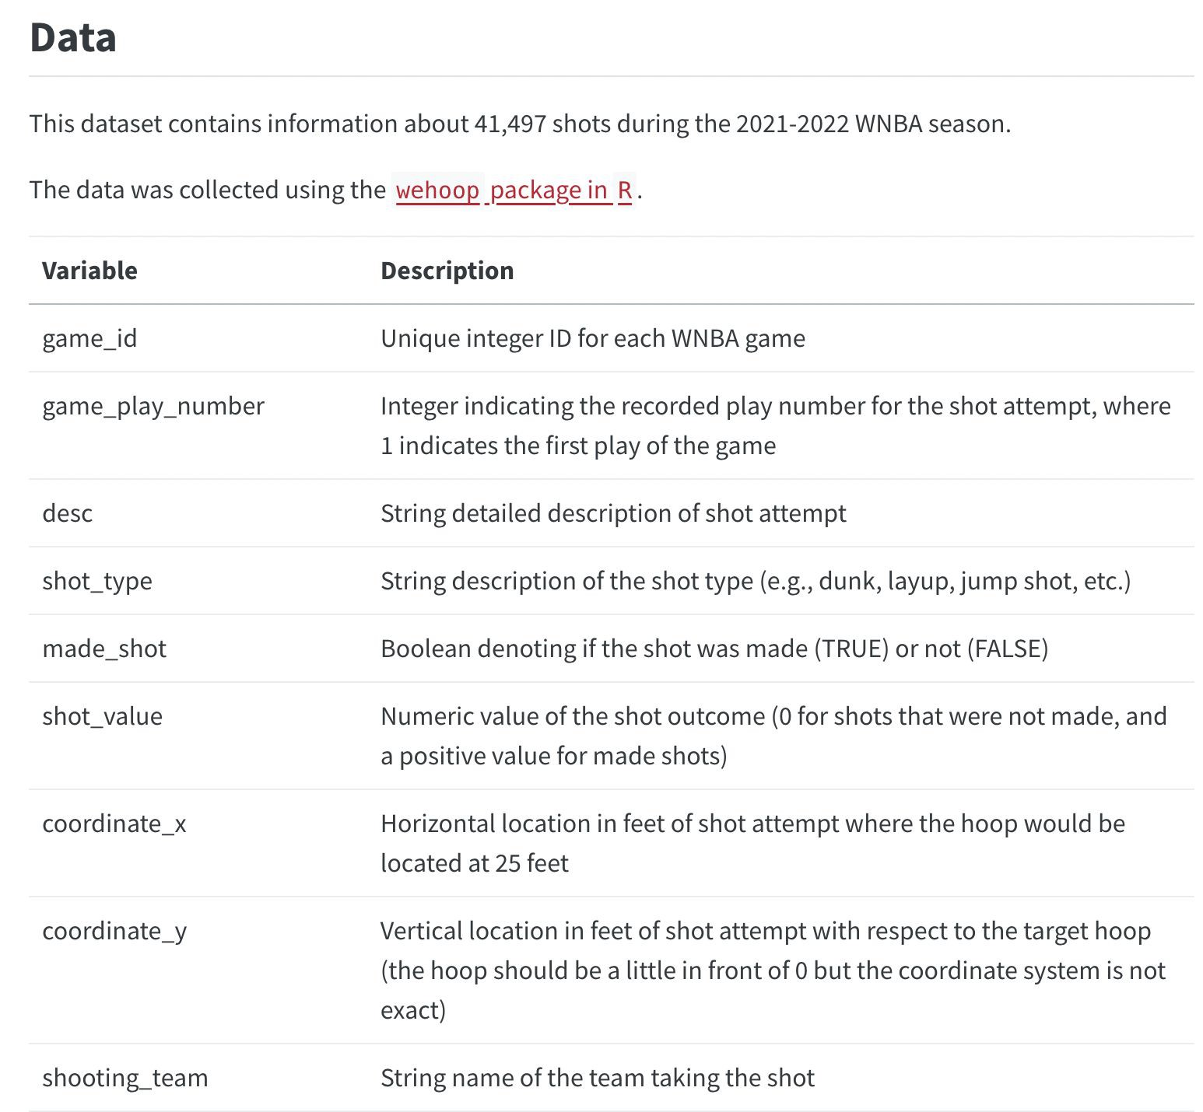
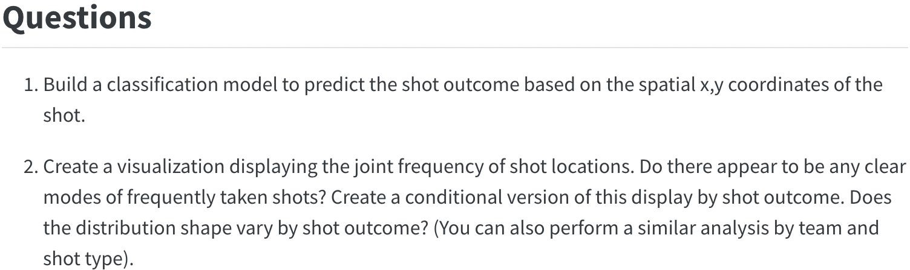
Example dataset page information

Slide 30
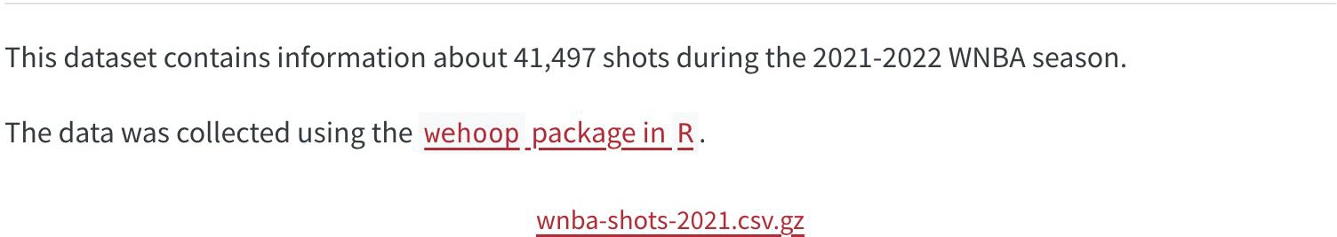
Dataset requirements
The data must be publicly shareable
If you used code (such as an
R
package) to access the data then include your code with your submission.
The code will be publicly available on the repository’s GitHub page for others to view.
There should be an interesting sports question coupled with a statistics and data science topic to motivate the use of the dataset in educational material.
The dataset should be in a standard format such as a CSV ﬁle and be of reasonable size. GitHub has a ﬁle size limit of 100 MB, and large ﬁles can be inconvenient for students. We recommend compressing ﬁles larger than a few megabytes. Note that gzip compression is a good choice since common tools such as
R
and
Python
feature ways to read .csv.gz ﬁles directly.
e.g., WNBA shot data was compressed and is available to download as .csv.gz

